Slide 1
AI SYNERGY HACKATHON 2026 | ABV-IIITM GWALIOR
TEAM NAME- LAMDA CALCULUS
CivicSaathi
Make every civic complaint understandable, traceable, and accountable across India.

Slide 2
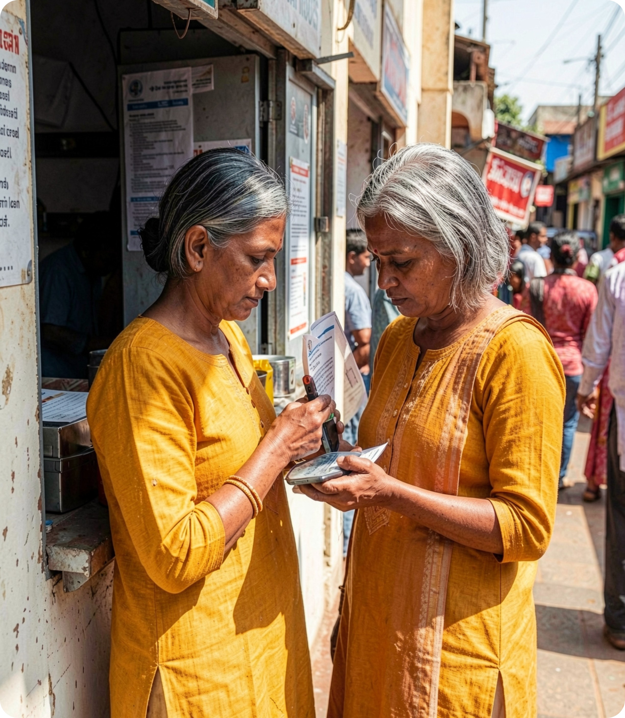



THE CIVIC THREAD
The civic problem is not reporting — it is losing the thread
Residents may not know which authority or channel fits their issue.
One real-world problem can become separate complaints across departments.
People lack a shared view of ownership, handoffs, and what happens next.

Slide 3
FINAL PROBLEM STATEMENT
Indian residents need one trusted case journey that connects their evidence to the right action, even when responsibility spans multiple departments.
Today’s systems often capture tickets; they do not make accountability legible.
The product must distinguish AI suggestions, citizen input, community signals, and verified official updates.

Slide 4
THE CORE PRODUCT IDEA
Our solution: one citizen problem, one accountable case
The resident’s story stays connected while the work branches behind it.
01
02
03
04
Capture
Coordinate
Explain
Confirm
Turn a plain-language report into a structured internal case.
Hold multiple department tasks without splitting the story.
Carry a reason and review state with every recommendation.
Show filing and status as verified only when genuinely confirmed.

Slide 5
CASE JOURNEY
From evidence to visible next step
01
02
03
Describe
Extract
Suggest
Resident describes the issue and adds location or evidence.
AI extracts details, suggests a category, and asks for missing information.
CivicSaathi recommends an authority or channel and surfaces possible related reports.
04
05
06
Review
Create
File
Resident or moderator confirms, corrects, or rejects the suggestions.
The system creates a case, links department tasks, and maintains a transparent timeline.
Guided filing preserves the draft until an official acknowledgement is actually received.

Slide 6




DECISION RIGHTS
AI accelerates the work. Humans own the decision.
AI
Citizen
Moderator
Official
Reads text and images, finds missing details, drafts complaints, explains possible matches, and suggests routing.
Verifies facts, corrects suggestions, approves consequential actions, and decides whether reports are related.
Handles disputed matches, harmful content, spam, and edge cases.
Confirms ownership, updates authoritative status, and makes the final operational decision.

Slide 7
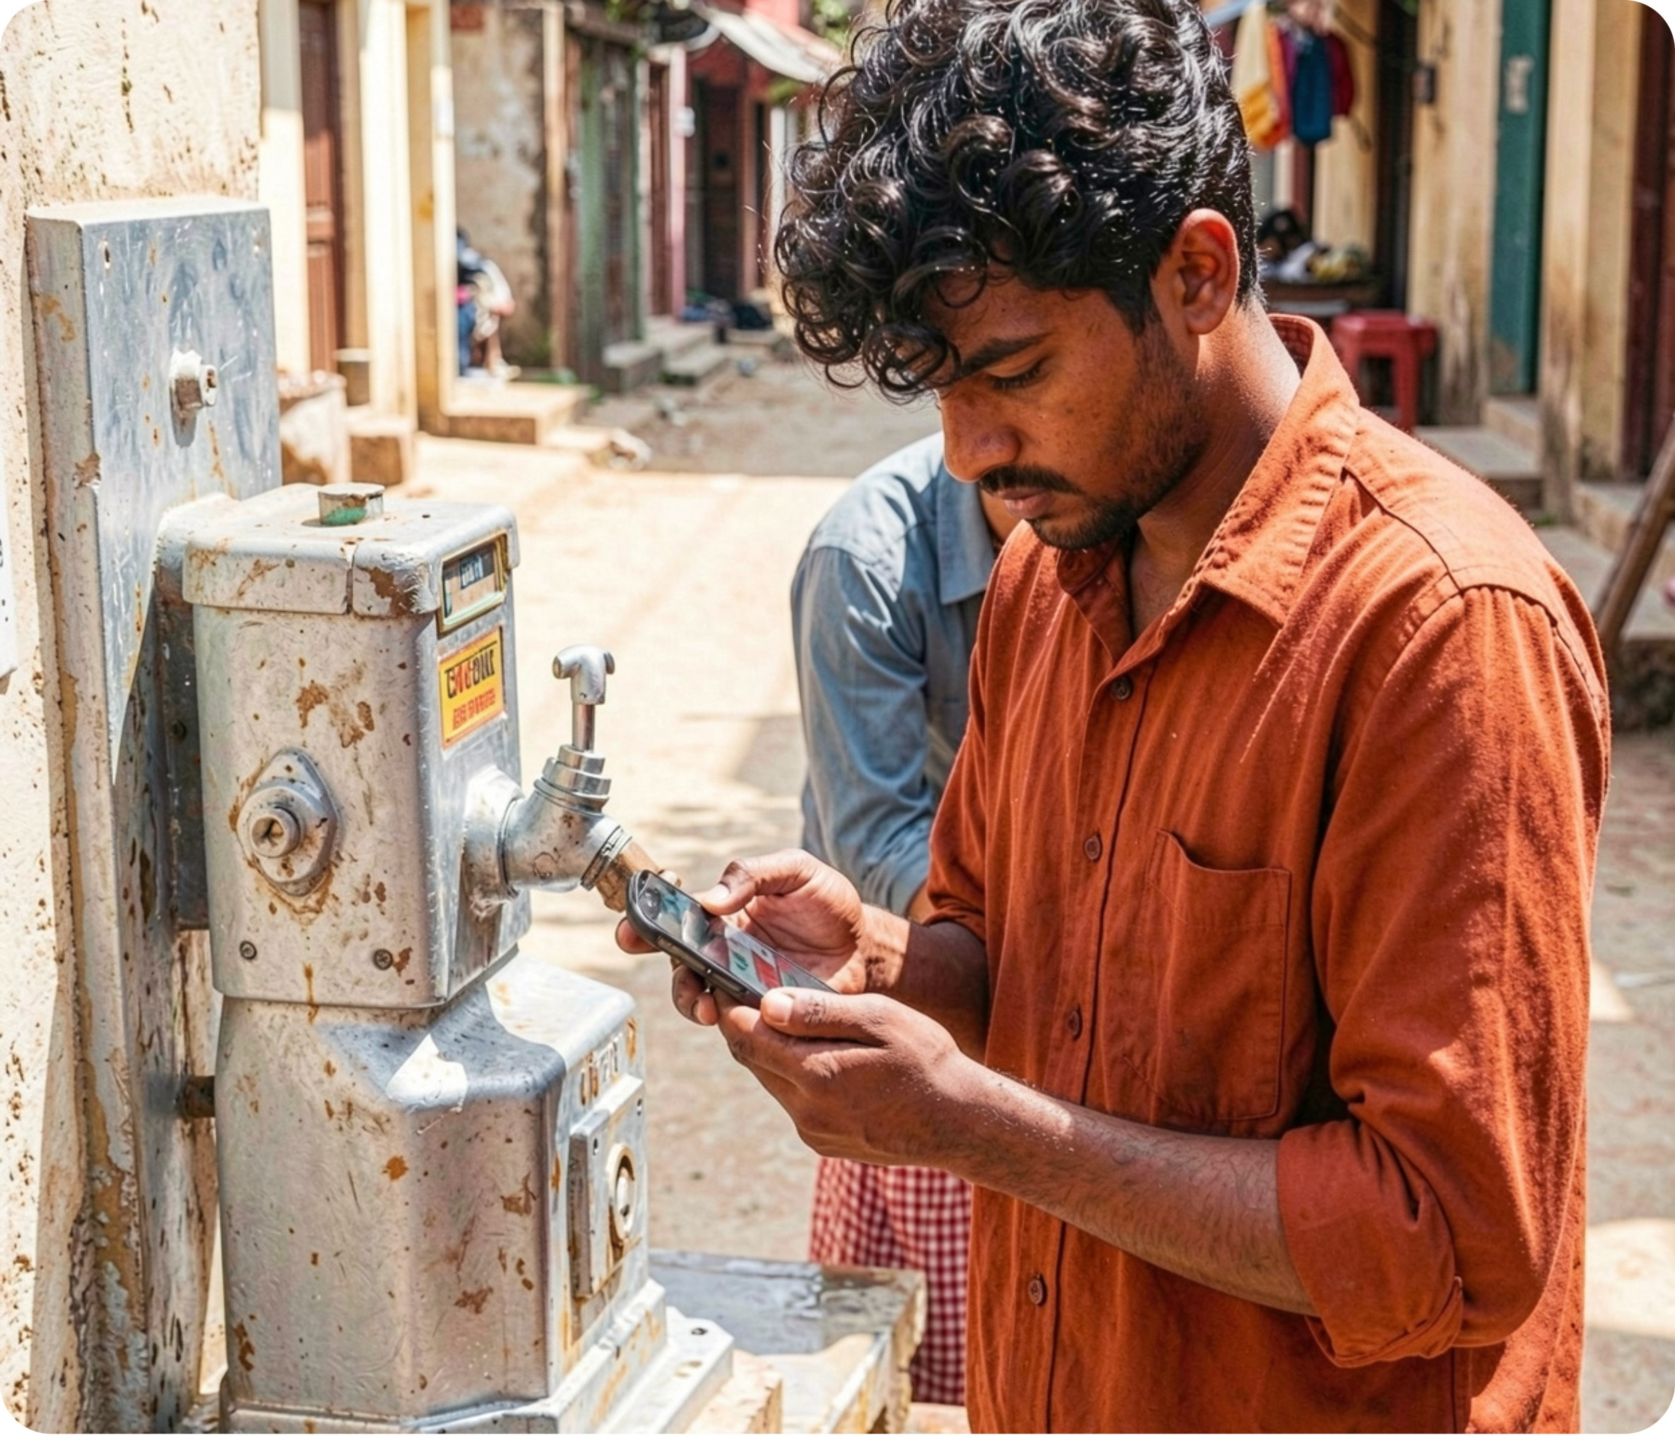
PROTOTYPE SCOPE
Feasible to prototype — valuable before any national integration
Citizen complaint form with text, location, and optional image.
Structured case summary, missing-field prompts, and authority suggestions with reasons.
Human review of related reports and department assignment.
Case timeline with separate task statuses and explicit confirmation states.
Synthetic cases for testing; guided filing where an authorised live integration is unavailable.

Slide 8





GUARDRAILS
Trust is designed into the workflow
Possible matches stay possible
No invented certainty
Never auto-merge similar reports; show a possible match for review.
Never invent a department, policy, contact, ticket ID, outcome, or partnership.
Privacy by default
Failure does not erase progress
Keep sensitive complaints private by default and separate community activity from private cases.
Preserve drafts when AI or an external service fails; never mark an unconfirmed filing as successful.
Consequential changes leave a trail
Log consequential changes with timestamp, source, and human reason.

Slide 9
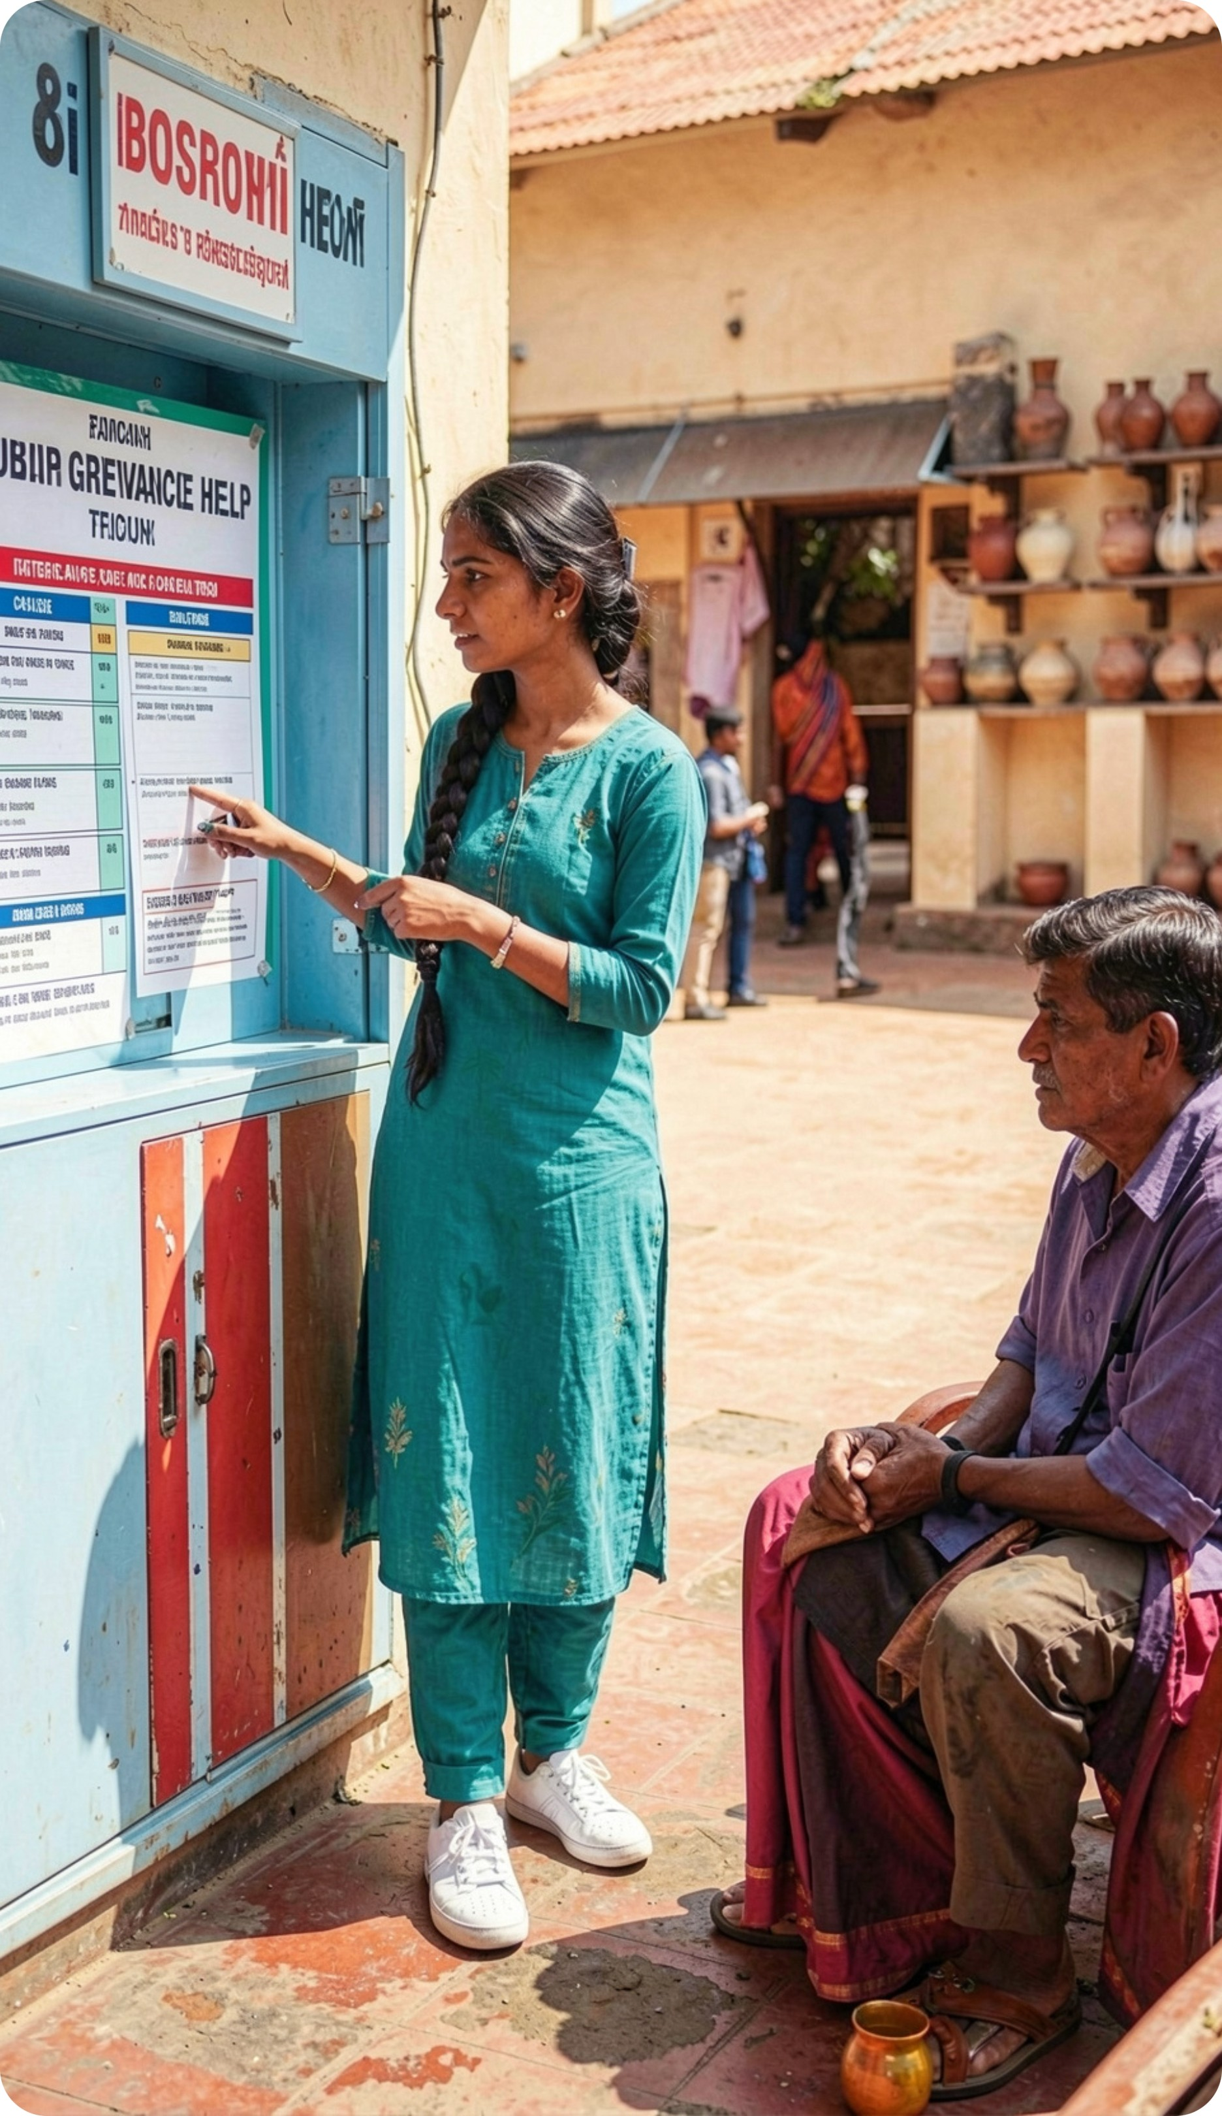
LIVE DEMONSTRATION
What we will demonstrate
A resident submits a messy civic issue; CivicSaathi turns it into a reviewable, multi-department case, understandable from report to next step.
Test an incomplete report: show the system asking instead of guessing.
Test two related reports: show human-reviewed linking, never automatic merging.
Show an official correction to a suggested owner, with the recorded reason.
Show graceful fallback when AI or filing support is unavailable.

Slide 10
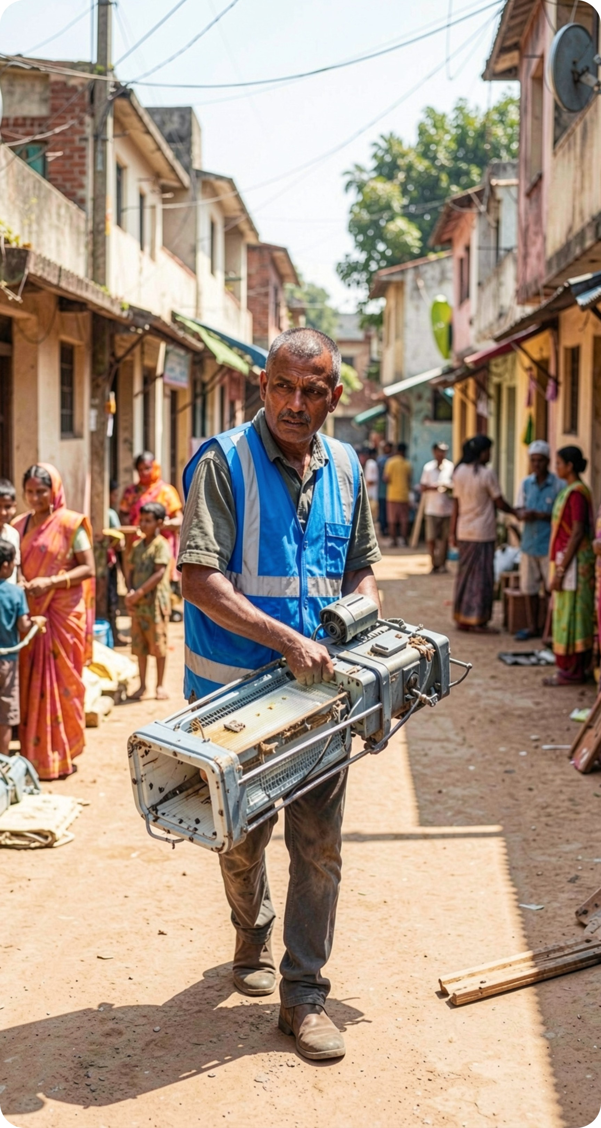
THE CIVICSAATHI PROMISE
Governance should be something citizens can follow
CivicSaathi makes the path from “I reported it” to “here is who owns the next step” visible — across cities, states, and civic systems.
AI suggests
People verify
Accountability stays connected

